Slide 1
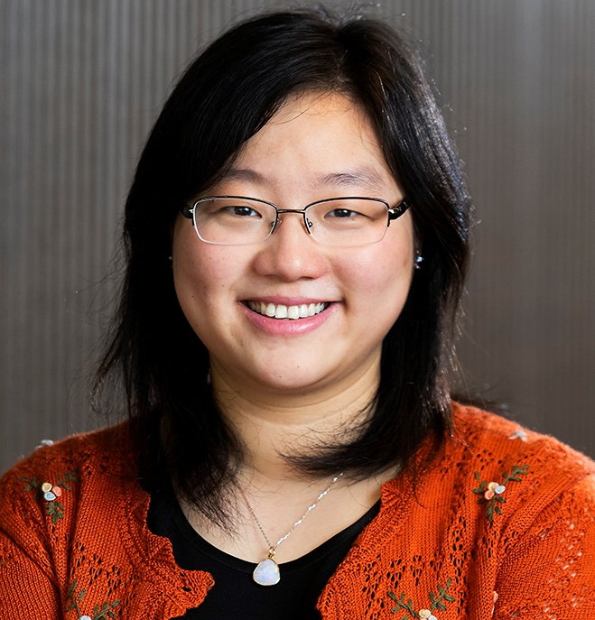
Introduction
INFT 4017 RESEARCH METHODS
Associate Professor Tina Du, course coordinator and lecturer, tina.du@unisa.edu.au

Slide 2
Learning objectives
Understand research concept and the essence of research.
Understand the basic process of empirical research and research design.
Understand the various research methods.
Understand the relationships between research questions and research methods.
Be able to describe and compare various methods and techniques.
Be able to produce a research paper.

Slide 3
Course content
This course introduces basic knowledge about conducting research in general, and provides opportunities to experience research processes including producing a research paper.
The purpose is not to train you to be a PhD student, rather, is to provide philosophies and fundamentals of research in general.

Slide 4
From this course, you will:
need to do lots of readings, thinking, discussions, and writings.
learn how to do annotated bibliography and literature review.
learn to propose and form research questions.
write a research paper with group members.
develop researching skills and critical analysis skills of the topic.
practise your research writing skills in multiple ways.
have flexibility to choose a topic that you find interesting and significant to work on.
get a chance to meet both early career and distinguished researchers.

Slide 5
Definition of research
Australian Code for the Responsible Conduct of Research
The meaning of ‘research’, as used in this Code, is original investigation undertaken to gain knowledge, understanding and insight.
It is a broad concept and there is no simple, single way to define research for all disciplines.

Slide 6
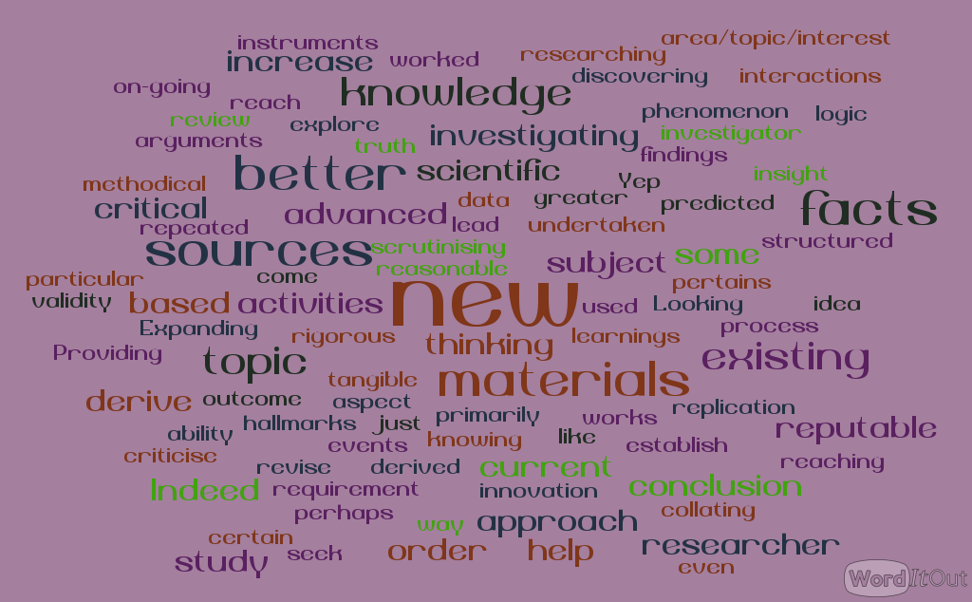
Research descriptions provided by our students in previous study periods

Slide 7
The essential of research
An essential feature of research is newness – innovation.
Invention – the making of something new – is a mysterious process for which no rules can be formulated. No one can hope to invent who has not in him/her some spark of creative ability; but this spark cannot burst into flame until an attempt is made to kindle it. Careful and thorough study, and painstaking experiment, are the only means by which any scientist, however talented, can hope to produce research of genuine quality.

Slide 8
Research methods
There is not a uniform research method either.
However, there are different “good practice” to follow, “bad practice” to avoid.
This is why we have this course.

Slide 9
Research methodology classification
Theoretical and empirical research
Qualitative and quantitative research
Applied research and pure research
Deductive and inductive research
Theory -> hypothesis -> Observation -> Test -> Conclusion
Observation -> pattern -> Tentative Conclusion -> Theory

Slide 10
Classification of research (Australian Research Council)
Pure basic research, which is experimental and theoretical work undertaken to acquire new knowledge without looking for long-term benefits other than the advancement of knowledge;
Strategic basic research, which is experimental and theoretical work undertaken to acquire new knowledge directed into specified broad areas that are expected to lead to useful discoveries. Such research provides the broad base of knowledge necessary to solve recognised practical problems;

Slide 11
Classification of research (ARC) cont.
Applied research, which is original work undertaken primarily to acquire new knowledge with a specific application in view. Such research is undertaken either to determine possible uses for the findings of basic research or to determine new ways of achieving some specific and predetermined objectives.

Slide 12
Research approaches
You can support your assertions by
Theoretical proof and analysis
Hypothesis test
Experiment
Simulation
Modelling
Survey
Case study
What do you do in your research?
How do you collect data?
What are good journals and conferences in your research area?

Slide 13
Research Degree Graduate Qualities
has an understanding of current research based knowledge in the field, its methodologies for creating new knowledge, and can create, critique, and appraise new and significant knowledge
is prepared for lifelong learning in pursuit of ongoing personal development and excellence in research within and beyond a discipline or professional area
is an effective problem solver, capable of applying logical, critical and creative thinking to a range of research problems
can work both autonomously and collaboratively as a researcher within a particular discipline or professional area and within wider but related areas

Slide 14
Research Degree Graduate Qualities
is committed to ethical action and social responsibility as a researcher in a discipline or professional area and as a leading citizen
communicates effectively as a researcher in a discipline or professional area and as a leading member of the community
demonstrates international perspectives in research in a discipline or professional area and as a leading citizen

Slide 15
Course information
This course introduces basic knowledge about conducting research in general, and provides opportunities to experience research processes.
Please be sure to read the Course Outline available on the course website.
Course website accessed via myUniSA

Slide 16
Overview of the assessments
Assessment 1 - Annotated bibliography: a summary of the literature you have reviewed and the relevance of each paper to your work;
Assessment 2 – Research Proposal/Methodology Design: the plan for addressing the research gap and the plan for working out how you can test/evaluate your work and others' work;
Assessment 3 - Research paper: writing an effective presentation of a research area.
Find your group members and form a group by the end of week 2!

Slide 17
Selection of a research topic
Suggested topics
Self-selected topic
Topic from a Honours project
Topic from a Minor Thesis
Topic based on your interest
Perceived gap in the literature
Please feel free to chat with Tina to discuss about the appropriateness of your research topic

Slide 18
Some criteria for the selection of a research topic:
Significance
Innovation
Reasonable amount of literature
Considering diverse backgrounds of your group members

Slide 19
Some areas and ideas of research topics
You might choose one of them or you can raise your own

Slide 20
Area 1: Social search and social computing
The sociality trait of information search has been prominent nowadays, for example, people search for information on social Q&A platforms and use social media for acquiring information. Recent advancements in social technologies allow information seekers to reach out to a larger, more distributed group of people online when searching for information (Jeon & Rieh, 2015).
Social search systems facilitate users to obtain tailored information, filter out information, and interact with real people. As an emerging online information search approach, social search not only challenges traditional theories of information seeking but influences people's everyday life information search practices.

Slide 21
Focusing on how technology intersects with social practices, this project will investigate social search goals, strategies, tactics, informational outcomes, and social outcomes. It also aims for providing implications for developers and designers of social search systems.
References:
Boydell, O. & Smyth, B. (2010). Social summarization in collaborative Web search. Information Processing & Management, 46(6), 782-798.
Jeon, G. Y., & Rieh, S. Y. (2015). Social search behavior in a social Q&A service: Goals, strategies, and outcomes. In Proceedings of the Annual Meeting of the Association for Information Science and Technology (ASIS&T 2015).

Slide 22
Area 2: Vulnerable communities in the digital age
Digital technologies have a radical impact on vulnerable people's everyday lives including searching for and using valuable information. Questions of equality and social justice are as important as ever in the information age. There have been concerns about issues around bias, social exclusion, misinformation and information sharing hazards.
Vulnerable people typically include women and children, ethnic people of colour, immigrants, gay men and lesbians [currently people from LBGTQI populations], the homeless, and the elderly (Du et al., 2017).

Slide 23
Understanding information behaviours of vulnerable communities and its evolution in the digital age is a critical area of research and practice within the field of information science and technology which provides an excellent venue to discuss this crucial topic at the intersection of information, society, and technology.
This project focuses on the design and use of social technologies for/with vulnerable populations, associated ethical issues, and creative uses of new technologies for social inclusion.

Slide 24
References:
Du, J. T., Xie, I., Narayan, B., Sayyad Abdi, E., Wu, H.J. Liu, Y-H., & Westbrook, L. (2017). Vulnerable communities in the digital age: Advancing research and exploring collaborations. In the Proceedings of the iConference 2017 (pp.911-914). Available at http://hdl.handle.net/2142/96785
Du, J. T. & Haines, J. (2017). Indigenous Australians’ information behaviour and Internet use in everyday life: An exploratory study. Information Research (IR), 22 (1), paper 560. Available at http://www.informationr.net/ir/22-1/paper737.html

Slide 25
Area 3: Information and community supports for immigrant youth and children
Population is a central issue for any nation, but particularly for one composed mainly of recent immigrants that is continuing to build itself on immigration. The results of the Australian Bureau of Statistics 2016 Census showed that more than a quarter (26%) of Australia’s population (6,163,667 people) were born overseas, with many of these arriving as young adults, youth, and children.
This project will investigate and understand how immigrant youth engage with their family, friends, and everyday life around information and social media and how all of this can be better supported through social and community services such as public library programs.

Slide 26
The knowledge gained from this study will recommend strategies that librarians and service providers can use to help public libraries design better services for immigrant populations by focusing on what works best for their youth and children.
References:
Katz, I., & Redmond, G. (2009). Review of the Circumstances among Children in Immigrant Families in Australia. In Innocenti Working Paper - Special Series on Children in Immigrant Families in Affluent Societies (IWP-2009-12).
Khoir, S., Du, J. T., Davison, R. & Koronios, A. (2017). Contributing to social capital: An investigation of Asian immigrants’ use of public library services. Library and Information Science Research, 39 (1), 34–45.

Slide 27
Area 4: Group decision-making and information processing in leisure situations
While there is an emerging body of theoretical frameworks and models describing information seeking and processing as a collaborative process, the current literature in collaborative information seeking is generally based in workplace scenarios but neglects leisure situations.
In fact, leisure activities such as holiday travel is a frequently-raised context of collaborative information seeking but has not been thoroughly examined. This project aims to investigate issues in relation to group decision-making and information processing in the leisure context.

Slide 28
References:
Elbeshausen, S., Mandl, T., & Womser-Hacker, C. (2015). Collaborative information seeking in the context of leisure and work task situations: a comparison of three empirical studies. In P. Hansen, C. Shah, & C.-P. Klas (Eds.), Collaborative Information Seeking: Best Practices, New Domains and New Thoughts (pp. 73–98). Springer International Publishing.
McNeese, N. J., & Reddy, M. C. (2017). The role of team cognition in collaborative information seeking. Journal of the Association for Information Science and Technology, 68(1), 129–140.

Slide 29
Topic 1: Can social media be used to increase the voting participation rate amongst young people?
It is known that young people, under 30 but particularly in the 18-24 age group, do not vote in Australian elections, even though it is compulsory. Many do not even register to vote, let alone turn up to vote. It could be considered that this disenfranchises this group of voters. Young people in this age range are however major users of social media. Is it possible to encourage young people to register and vote in Australian elections, using social media?
http://www.aec.gov.au/about_aec/research/caber/1b.htm

Slide 30
Topic 2: Social media usage and effectiveness in politics and election
Campaign online
Social Manipulation and Blogging
Social Media and Elections
G. A. Auger, "Fostering democracy through social media: Evaluating diametrically opposed nonprofit advocacy organizations’ use of Facebook, Twitter, and YouTube," Public Relations Review, vol. 39, pp. 369-376, 2013.
Y. M. Baek, “Political mobilization through social network sites: The mobilizing power of political messages received from SNS friends,” Computers in Human Behavior, vol. 44, pp. 12–19, Mar. 2015.

Slide 31
Topic 3: Can social media be used to support immigrants’ settlement in Australia?
International migration is a worldwide phenomenon. Helping immigrants settle well is a significant issue faced by countries such as the US, Canada and Australia. According to the ABS, the number of immigrants in Australia was 30.2% of the Australian population.
An important outcome of the capability to navigate information in a new landscape is increasing the likelihood of social inclusion in a new country. Moreover, social capital, the network relationships between individuals and communities, is an integral aspect of community development and a valuable component of immigrant settlement.

Slide 32
How immigrants use several sources to support themselves, such as social media, needs to be identified. This understanding of their information behaviour may contribute to new policies providing individual and community support.
Research shows that the use of social media enables a background awareness of friends and acquaintances that supports bonding capital and transnational communities.
The immigrants leverage social media to monitor others through voice, video, text, and pictures, maintain a low level mutual awareness and psychologically supports their community. This helps the integration process and facilitates their social relationships in a new country.

Slide 33
References:
Komito, L. (2011). Social media and migration: Virtual community 2.0. Journal of the American Society for Information Science and Technology, 62(6), 1075-1086.
Osatuyi, B. (2013). Information sharing on social media sites. Computers in Human Behavior, 29(6), 2622-2631.

Slide 34
Topic 4: Can social media be used to assist in trip planning?
There are 1.65 billion active mobile social media users worldwide who access social media through their smart mobile devices.
Social media is an increasingly important source for tourists seeking information about their intending holiday. Through social media, tourists can obtain travel related information by interacting with their social networks.

Slide 35
In a social media environment, social interactions may be enabled between strangers, between known and unknown persons and between known persons.
Due to the widespread use of social media on smart mobile devices and the popularity of sharing travel aspirations and experiences among tourists, social media plays an increasingly important role in tourism.
Studies have shown that travelers rely more on the suggestions and reviews provided by experienced tourists for their trip planning and decision-making.

Slide 36
Trip planning with family or friends requires collaboration between tour members in gathering, sharing and verifying information, sharing of knowledge and experiences, as well as making decisions on the itinerary.
Collaboration in travel context is defined as a group of travelers conduct several activities together, including searching, sharing, gathering and validating of information, by means of social media in order to make decisions on travel products during the trip planning.
In collaborative environment, tourists’ information searching behaviors, reasons of collaboration and ways of collaboration on social media need to be explored.

Slide 37
What is the role of social media in collaboration for trip planning?
How is social media used during the trip planning?
What is the influence of social media on the trip planning?
References:
Evans, B. M., Kairam, S., & Pirolli, P. (2010). Do your friends make you smarter?: An analysis of social strategies in online information seeking. Information Processing & Management, 46(6), 679–692.
Hudson, S., & Thal, K. (2013). The impact of social media on the consumer decision process: Implications for tourism marketing. Journal of Travel & Tourism Marketing, 30(1– 2), 156–160.
Zeng, B., & Gerritsen, R. (2014). What do we know about social media in tourism? A review. Tourism Management Perspectives, 10, 27–36.

